Slide 1
Statistical and Predictive Modeling 2
Assignment #5– Decision tree and random forest Name: Paramvir singh Bali Student number: 100843502

Slide 2
Rational statement
In the given dataset there are 143 observation and 7 variables .
In this assignment, I will present model analysis pf both Decision tree and Random forest model.
Further I will present confusion matrix/classification report for optimized Decision tree and Random forest model.
Present the feature importance of both Decision tree and Random forest

Slide 3
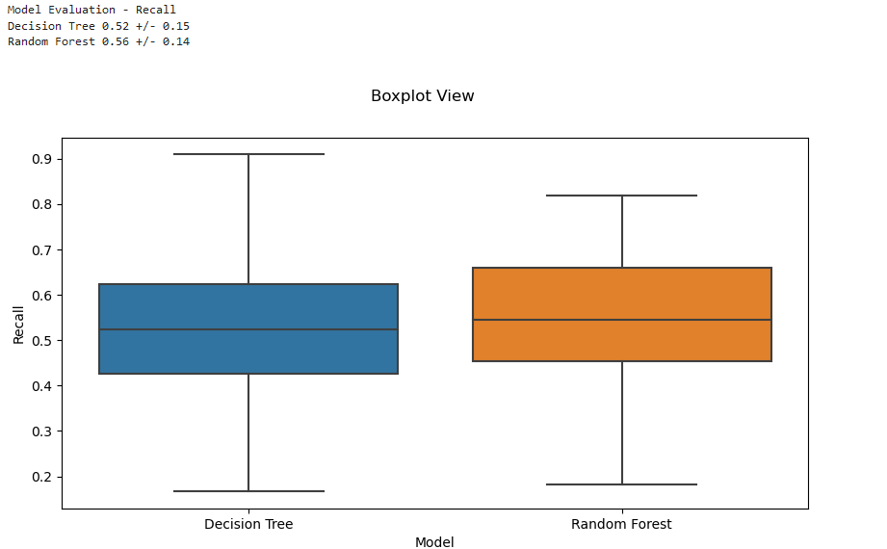
Presentation of model analysis(box plot)
Explanation of box plot for decision tree model:
Quartile 1(Q1): 25% of decision attribute(happy or not happy) has recall equal to or less than 0.42 for decision tree model
Quartile2(Q2): 50% of decision attribute(happy or not happy) has recall equal to or less than 0.52 for decision tree model
Quartile3(Q3): 75% of decision attribute has recall equal to or less than 0.63 for decision tree model.
There are no outliers
Box plot equally distributed or equally skewed
Explanation of BOX plot for random Forest model:
Quartile1(Q1): 25% of decision attribute(happy or not happy) has recall equal to or less than 0.43 for random forest model
Quartile2(Q2): 50% of decision attribute(happy or not happt) has recall equal to or less than 0.56 for random forest model.
Quartile3(Q3): 75% of decision attribute(happy or not happy) has recall equal to or less than 0.65
There are no outliers

Slide 4

Presentation of the confusion metrics and classification report for the optimized Decision tree
Confusion matrix is N×N table(where N is the number of the classes) that contains number of incorrect and correct predictions of the classified model.
True negative: when both case and prediction is negative.Here 8 is the true negative means 8 times the model predicted unhappiness correctly out of 29 times .
True positive: when both case and prediction is positive. Here 9 is the value of true positive means 9 times model predicted happiness correctly out of 29 times.
False positive: when case is negative and prediction is positive.Here the value of false positive is 5. It means the 5 times the model is predicting happiness wrongly however it is unhappiness in reality.
False negative : when case is positive and prediction is negative. Here the value is 7. it means 7 times the model is predicting unhappiness wrongly however it is happiness.

Slide 5

Presentation of the confusion metrics and classification report for the optimized Random forest model
Confusion matrix is N×N table(where N is the number of the classes) that contains number of incorrect and correct predictions of the classified model.
True negative: when both case and prediction is negative.Here 6 is the true negative means 6 times the model predicted unhappiness correctly out of 29 times .
True positive: when both case and prediction is positive. Here 11 is the value of true positive means 11 times model predicted happiness correctly out of 29 times.
False positive: when case is negative and prediction is positive.Here the value of false positive is 7. It means the 7 times the model is predicting happiness wrongly however it is unhappiness in reality.
False negative : when case is positive and prediction is negative. Here the value is 5. it means 5 times the model is predicting unhappiness wrongly however it is happiness.

Slide 6
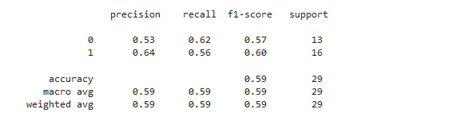
Three key insights from optimized decision tree model
Precision means what proportion of predicted positives is truly positive.
Precision = truly positive/(truly positive +false negative)
The weighted average precision for this 59% efficient which is good. The value of the weighted average precision explains that only 59% of the predicted positive of this model are actually detected as true value and rest 41% predicted value are not actually detected as true positive.
Recall explain what proportion of actual positive is classified or detected.
Recall = true positive/ (true positive+false positive)
The weighted average recall for this model is 59% efficient which is good. The value of the weighted average recall explain that only 59% of actual positive is detected and rest 41% predicted value are not actual positive.
F1 score is the harmonic mean of precision and Recall. It is the combination of precision and Recall.
We use F1 score because there is always a trade off between Recall and precision i.e if we train our model to increase precision then Recall will decrease and vice versa.
The weighted average F1 score for decision tree algorithm is 59% efficient which is good and normal.

Slide 7
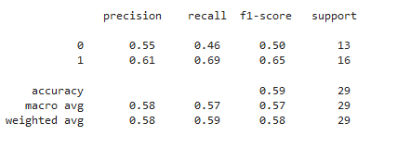
Three key insights from optimized Random forest model
Precision means what proportion of predicted positives is truly positive.
Precision = truly positive/(truly positive +false negative)
The weighted average precision for this 58% efficient which is good. The value of the weighted average precision explains that only 58% of the predicted positive of this model are actually detected as true value and rest 42% predicted value are not actually detected as true positive.
Recall explain what proportion of actual positive is classified or detected.
Recall = true positive/ (true positive+false positive)
The weighted average recall for this model is 59% efficient which is good. The value of the weighted average recall explain that only 59% of actual positive is detected and rest 41% predicted value are not actual positive.
F1 score is the harmonic mean of precision and Recall. It is the combination of precision and Recall.
We use F1 score because there is always a trade off between Recall and precision ie if we train our model to increase precision then Recall will decrease and vice versa.
The weighted average F1 score for random forest algorithm is 58% efficient which is good and normal.

Slide 8
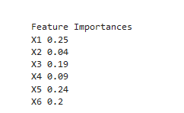
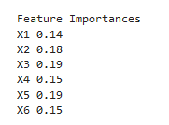
Features importance for decision tree and random forest model respectively
Feature importance for decision tree:X1(the availability of information about the city services) is the most important features/column among all features followed by X5(he maintenance of streets and sidewalks) , X3(the overall quality of public schools), X4(your trust in the local police) and X6 (the availability of social community events) is the least important features/column of the decision tree model
Features importance for random forest: here X5(he maintenance of streets and sidewalks) and X3(the overall quality of public schools) is the most important features/column followed by X2(he cost of housing), then X4(your trust in the local police) and X6(he availability of social community events) X1(he availability of information about the city services) is the least important features/column of the random forest model.

Slide 9
Three recommendations for Mr hughes
Specify the maximum depth of the trees. By default, trees are expanded until all leaves are either pure or contain less than the minimum samples for the split. This can still cause the trees to overfit or underfit. Play with the hyperparameter to find an optimal number for max_depth.
Increase or decrease the number of estimators. More trees usually means higher accuracy at the cost of slower learning. If I wish to speed up your random forest, lower the number of estimators. If I want to increase the accuracy of your model, increase the number of trees
Specify the maximum number of features to be included at each node split. This depends very heavily on your dataset. If our independent variables are highly correlated, I’ll want to decrease the maximum number of features. If our input attributes are not correlated and our model is suffering from low accuracy, increase the number of features to be included.

Slide 10
References
Week11 - Data2204-Notes
An Introduction to Statistical Learning-Springer Texts in Statistics E book
https://www.keboola.com/blog/random-forest-regression

